Slide 1
11.3

Slide 2
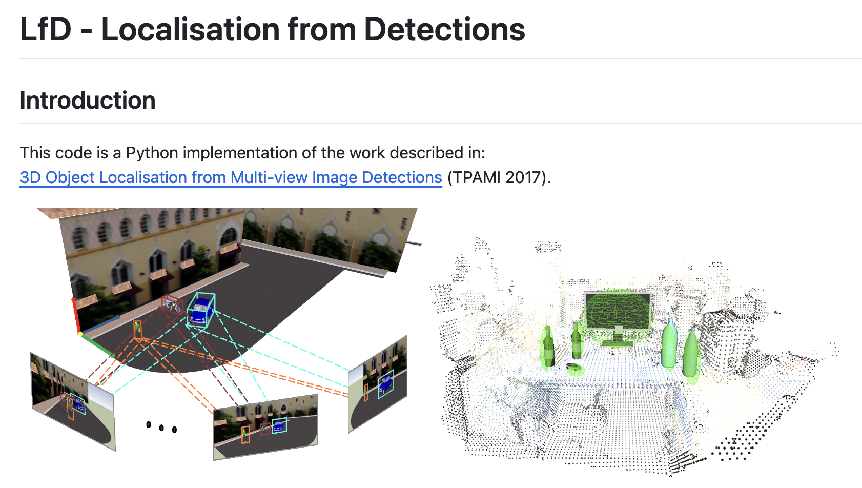
Progress
Setting up environment and runing the code successfully

Slide 3
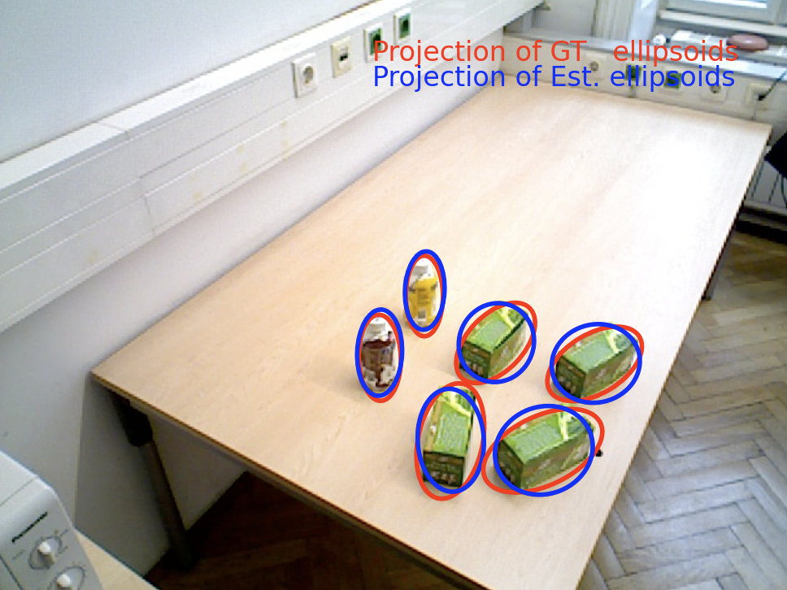
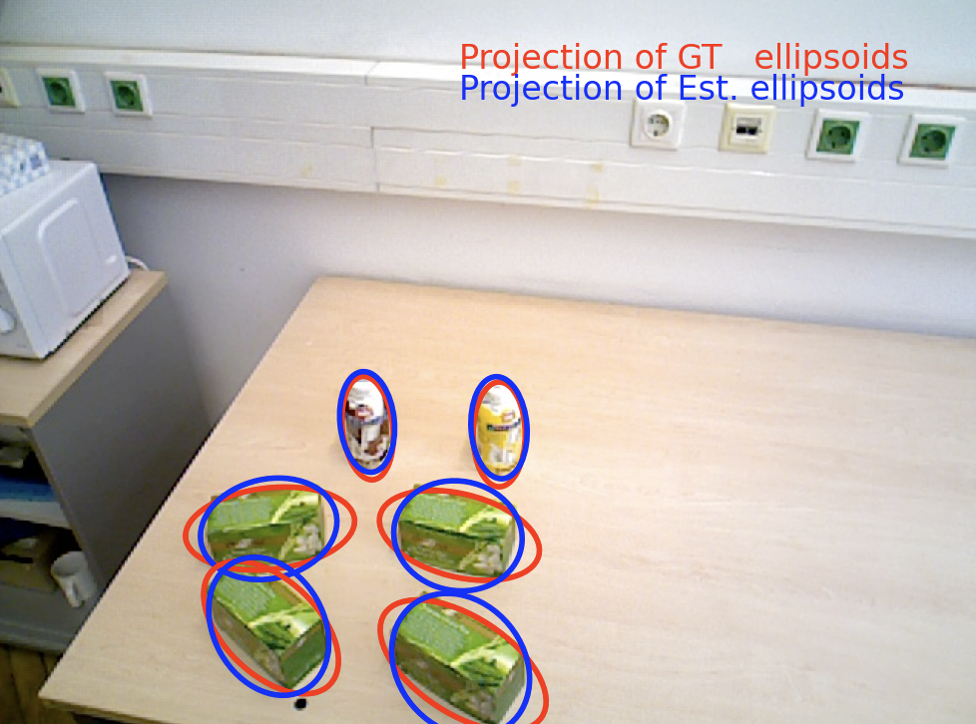
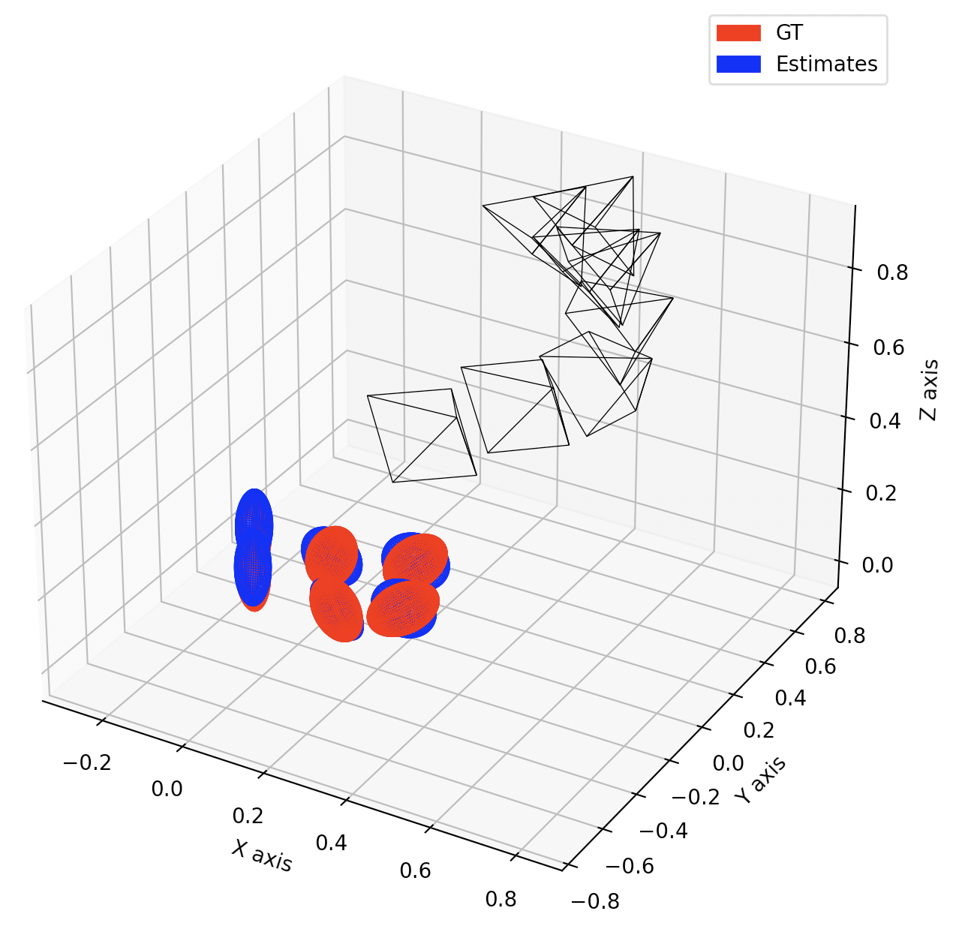
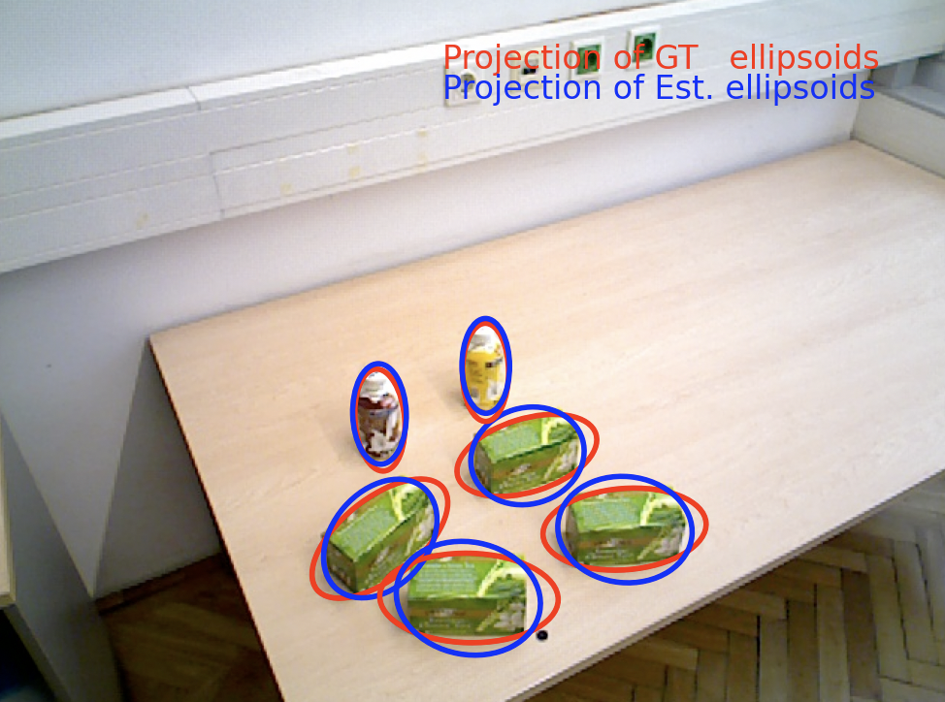
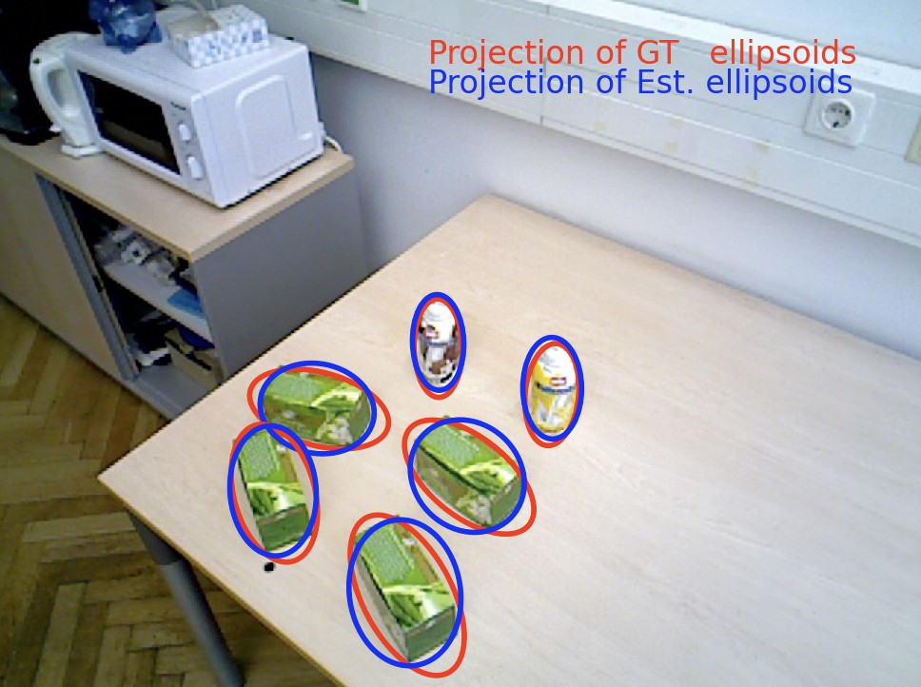
Progress
Result on demo data

Slide 4
Progress
Data format:
2D Bounding Box Data: [ n_frames * (n_objects x 4) ]
Camera Intrinsics Matrix: [3 x 3]
Camera Pose (Extrinsics) Matrix: [ n_frames * (4 x 3) ]
Visibility Matrix: [ n_frames * n_objects ]
Ground Truth 3D Ellipsoids: [ n_objects * (4 x 4) ]
Image Data
.npy file
.bin file

